Slide 1
Macro and Bit Manipulation

Slide 2

Objectives
Macro
Bitwise Operations
Bit Fields

Slide 3

Macro
Macro definition
Object-like Macros
Function-like Macros
Stringification and Concatenation
Undefining and Redefining Macros

Slide 4
Macro Definition
What is macro
A macro is a fragment of code which has been given a name. Whenever the name is used, it is replaced by the contents of the macro
Macro is defined using #define preprocessor directive in the C language.
When to use
When creating constants that represent numbers, strings or expressions.
Macro classification
Predefined macro
User-defined macro

Slide 5
Object-like macros
#define MACRO_NAME macro’s body
Upper case
Give symbolic names to numeric constants
The macro’s body end at the end of the #define line
Single line macro:
#define SIZE 10
Multiple line macro:
#define NUMBERS 1, \
2

Slide 6
Function-like macros
#define macro_name(list of parameters) macro’s body
Lower case
No white space
extern void foo(void);
#define foo() /* optimized inline version */
#define f () callback()
...
foo(); → ?
funcptr = foo; → ?
f() → ?
?
#define min(X, Y) ((X) < (Y) ? (X) : (Y))
x = min(a, b); ==> x = ((a) < (b) ? (a) : (b));
y = min(1, 2); ==> y = ((1) < (2) ? (1) : (2));
Notes:
Phần ?: giảng viên sẽ hỏi học viên, yêu cầu giải thích

Slide 7
Stringification and token pasting
struct command {
char *name;
void (*function) (void);
};
#define COMMAND(NAME) { #NAME, NAME ## _command }
struct command commands[] = {
COMMAND (quit),
COMMAND (help),
};
struct command commands[] = {
{ "quit", quit_command },
{ "help", help_command },
};
Token pasting preprocessing operator
Stringification preprocessing operator

Slide 8
Undefining and Redefining Macros
#ifdef TRUE
#undef TRUE
#define TRUE 1
#endif

Slide 9
BITWISE OPERATION (1)
Symbol | Operation
& | bitwise AND
| | bitwise inclusive OR
^ | bitwise XOR (eXclusive OR)
<< | Left shift
>> | Right shift
~ | bitwise NOT (one's complement) (unary)
bit a | bit b | a & b | a | b | a ^ b
0 | 0 | 0 | 0 | 0
0 | 1 | 0 | 1 | 1
1 | 0 | 0 | 1 | 1
1 | 1 | 1 | 1 | 0
bit a | ~a
0 | 1
1 | 0

Slide 10
BITWISE OPERATION (2)
Shift operations
A <<3
Bit7
Bit6
Bit5
Bit4
Bit3
0
0
0
0
A >> 3
0
0
0
Bit5
Bit4
Bit3
Bit2
Bit0
0

Slide 11
BITWISE OPERATION (3)
#include <stdio.h>
void main() {
unsigned int a = 60; /* 60 = 0011 1100 */
unsigned int b = 13; /* 13 = 0000 1101 */
int c = 0;
c = a & b; /* 12 = 0000 1100 */
printf("Line 1 - Value of c is %d\n", c );
c = a | b; /* 61 = 0011 1101 */
printf("Line 2 - Value of c is %d\n", c );
c = a ^ b; /* 49 = 0011 0001 */
printf("Line 3 - Value of c is %d\n", c );
c = ~a; /*-61 = 1100 0011 */
printf("Line 4 - Value of c is %d\n", c );
c = a << 2; /* 240 = 1111 0000 */
printf("Line 5 - Value of c is %d\n", c );
c = a >> 2; /* 15 = 0000 1111 */
printf("Line 6 - Value of c is %d\n", c );
}
OUTPUT:
Line 1 - Value of c is 12
Line 2 - Value of c is 61
Line 3 - Value of c is 49
Line 4 - Value of c is -61
Line 5 - Value of c is 240
Line 6 - Value of c is 15

Slide 12
Bit Fields - 1
This structure requires 8 bytes of memory space but in actual, we are going to store either 0 or 1 in each of the variables. The C programming language offers a better way to utilize the memory space in such situations.
struct {
unsigned int widthValidated;
unsigned int heightValidated;
} status;

Slide 13
Bit Fields - 2
struct {
unsigned int widthValidated : 1;
unsigned int heightValidated : 1;
} status;
The above structure requires 4 bytes of memory space for status variable, but only 2 bits will be used to store the values.
If you will use up to 32 variables each one with a width of 1 bit, then also the status structure will use 4 bytes. However as soon as you have 33 variables, it will allocate the next slot of the memory and it will start using 8 bytes.

Slide 14

Bit Fields - 3
#include <stdio.h>
#include <string.h>
/* define simple structure */
struct {
unsigned int widthValidated;
unsigned int heightValidated;
} status1;
/* define a structure with bit fields */
struct {
unsigned int widthValidated : 1;
unsigned int heightValidated : 1;
} status2;
int main( ) {
printf( "Memory size occupied by status1 : %d\n", sizeof(status1));
printf( "Memory size occupied by status2 : %d\n", sizeof(status2));
return 0;
}
OUTPUT:

Slide 15
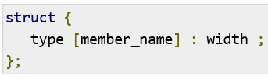
Bit Field Declaration - 1
The declaration of a bit-field has the following form inside a structure:

Slide 16
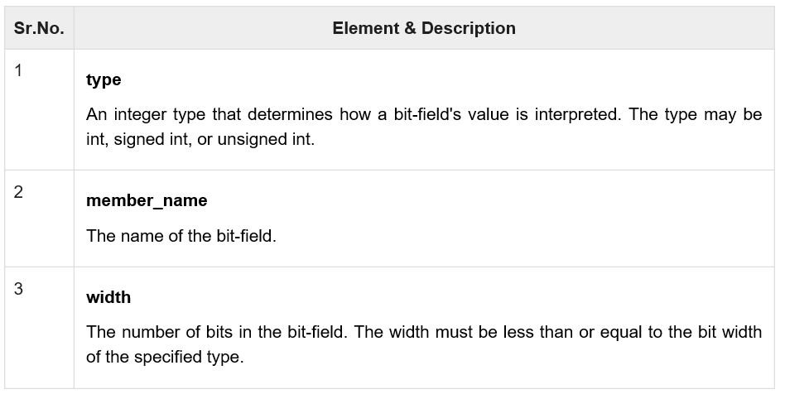
Bit Field Declaration - 2
The following table describes the variable elements of a bit field:

Slide 17
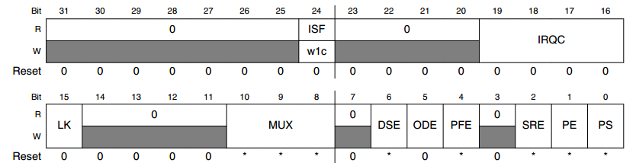
Quiz(1)
The figure show the description of register PCR.
Write macros to define MASK and SHIFT location of each bit field.
Write macro to set IRQC to 3

Slide 18
Quiz(2)
Write macro to convert 32bit value from big endian to little endian form

Slide 19

Thank you
Q&A

